Slide 1
ML Ops Summary

Slide 2
Table of Contents
Framework / Benefits (3)
ML Engineering Flow (4)
Feature Transformation (22)
Feature Selection (33)
Metadata (43)
Optimization (48)
High Performance Modeling (52)
Knowledge Distillation (54)
Model Production Analysis / Monitoring (57)
Model Debugging (65)
Model Interpretability (67)
Model Serving (70)

Slide 3
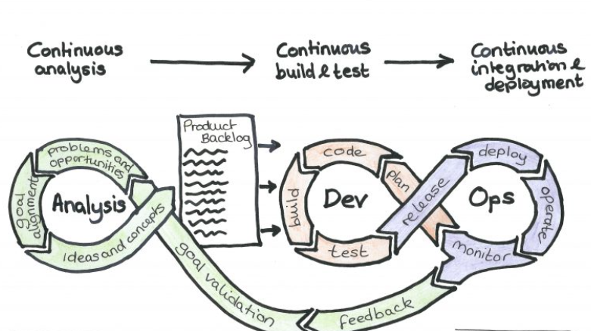
ML Ops Framework
What is ML Ops?
Machine Learning Operations (ML Ops) is an automated engineering framework that represents a set of transformative workflow practices designed to streamline the deployment and maintenance of data science models.
What are the benefits?
1. Accelerated Model Deployment:
Reduced time-to-market leads to quicker realization of business value.
2. Automated Process:
Automation reduces manual errors and accelerates the development lifecycle.
3. Cost Optimization:
Cost savings from auto-scaling and efficient resource allocation and utilization.
4. Scalability, Flexibility, Agility:
Increased portability of work across BUs promoting collaboration and efficient utilization of models
Scales seamlessly to handle increasing data and model complexity.
Adapts to changing business requirements and market dynamics.
Enables quick experimentation and iteration for innovation and support of citizen developers.
5. Monitoring and Alerting:
Real-time monitoring of model performance and health.
Proactive alerting to identify and address issues promptly.
6. Enhanced Security Measures:
Robust security protocols to protect sensitive data.
Compliance with data protection and privacy regulations.
Research
ML Ops Automation

Slide 4
ML Engineering Flow

Slide 5
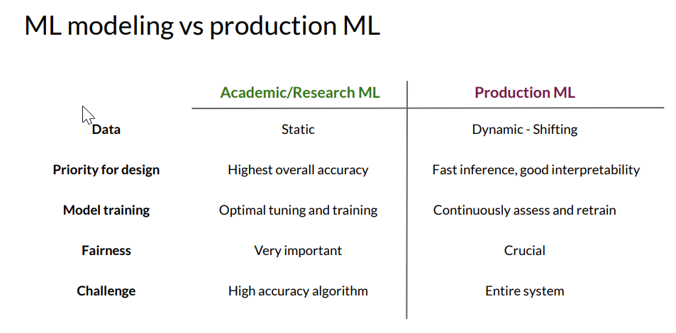
Notes:
Academia vs production level ml. we can see here that what you may use in a formal research setting generally has better data and less reasons for a full ml pipeline

Slide 6
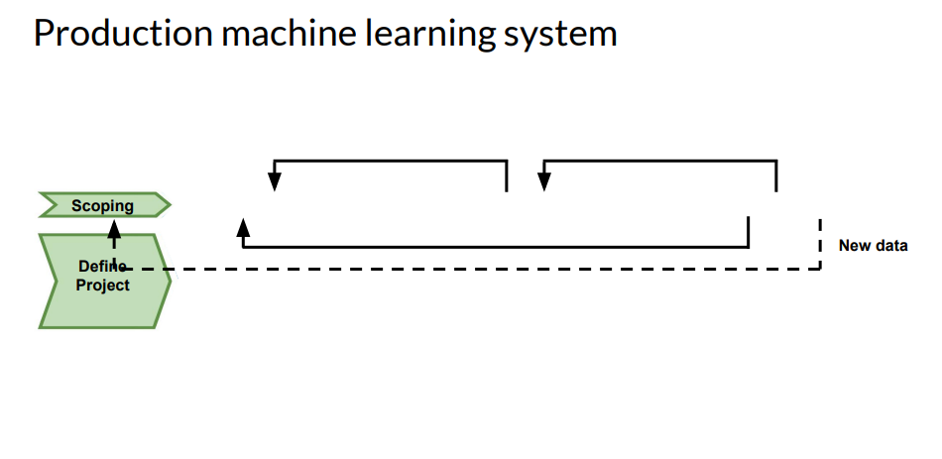
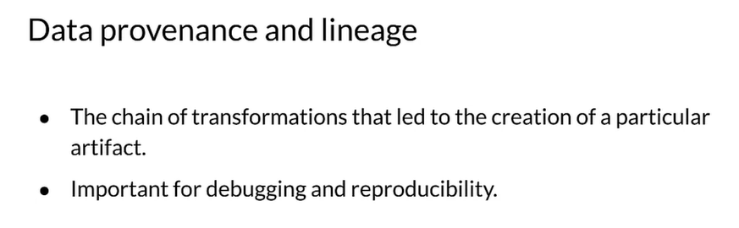
Notes:
We want to track where the data is from, provenance is the order of it throughout the process, and lineage is where the data is from. This is important for debugging at scale.

Slide 7
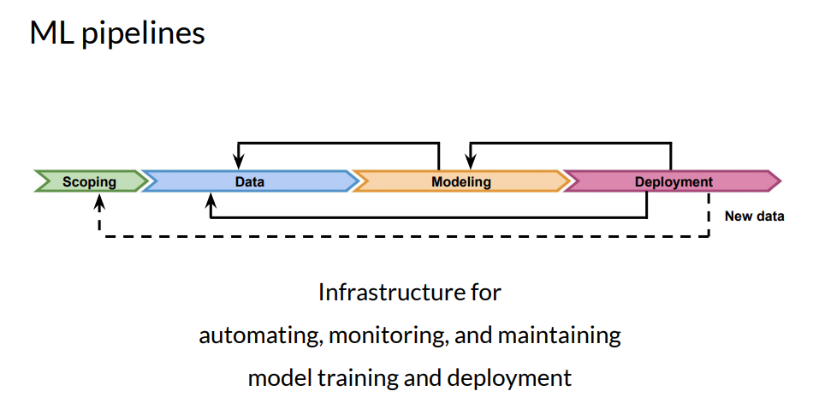
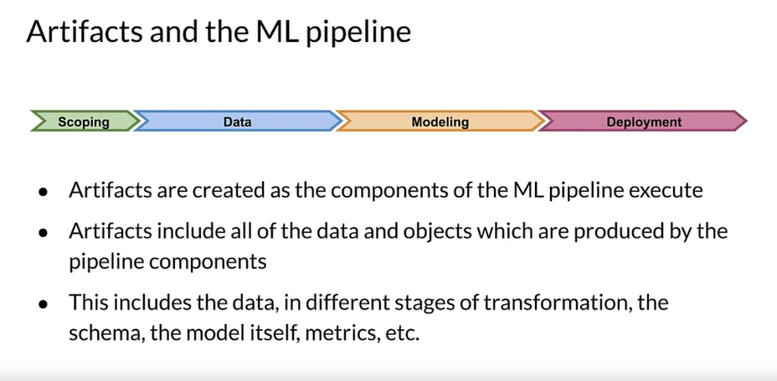
Notes:
Pipeline and where the artifacts are created. Any result produced in the pipeline is an artifact

Slide 8
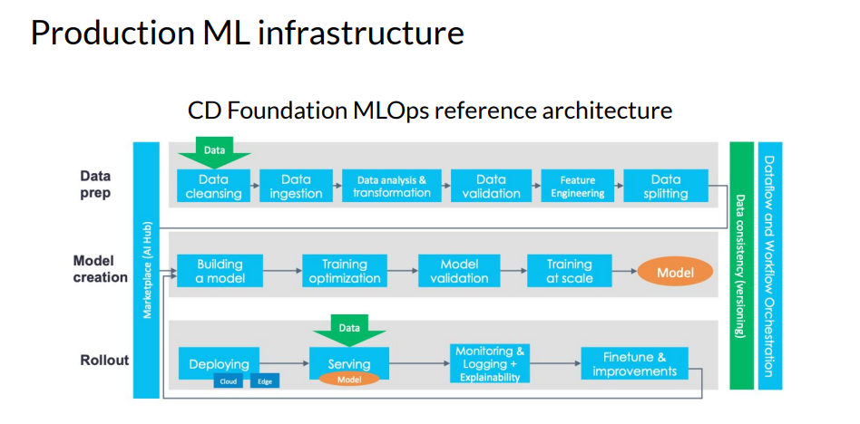
Notes:
Full flow that we will be covering in the slides

Slide 9
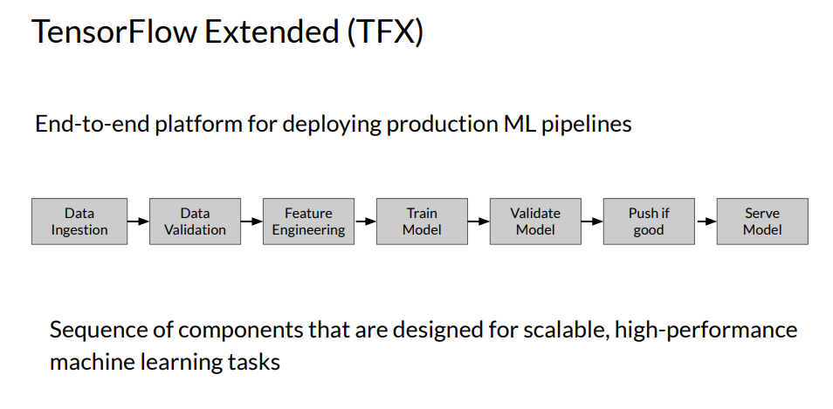
Notes:
This is the full flow but using TFX, a tensorflow version of ml pipelining.

Slide 10
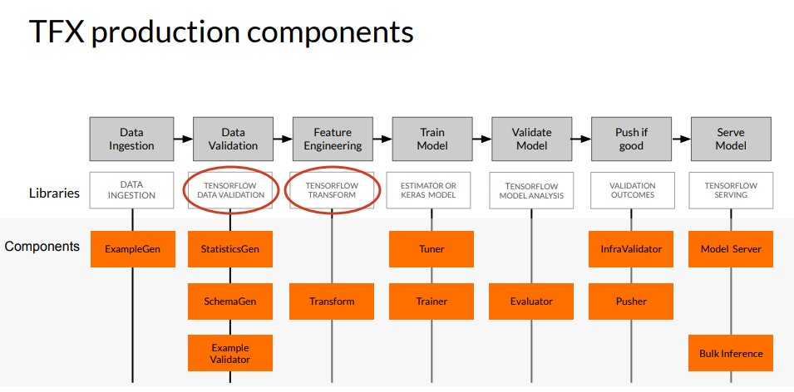
Notes:
Deeper dive into the components of TFX and each of their components that we will cover. For ml pipelining many of these components will be similar with other products just named differently.

Slide 11
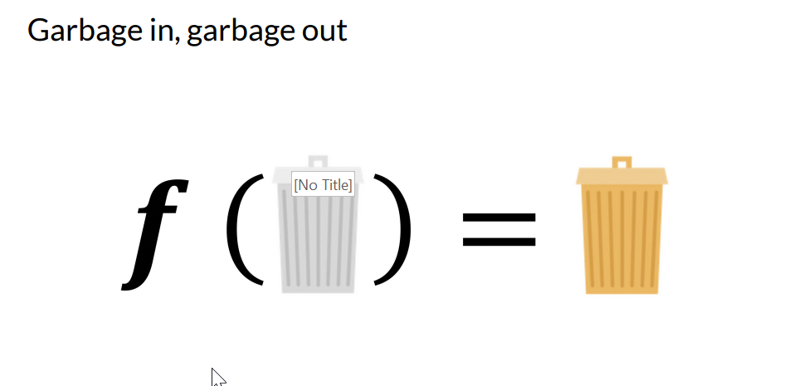
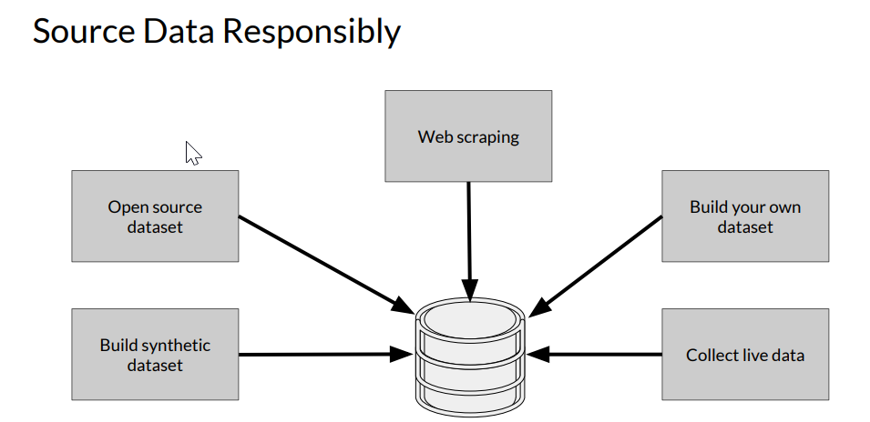
Notes:
Cmon I don’t need to actually have a slide for this but it is so important I did anyways. We are the DATA science team not the modeling team, we need good data to create GOOD models.

Slide 12
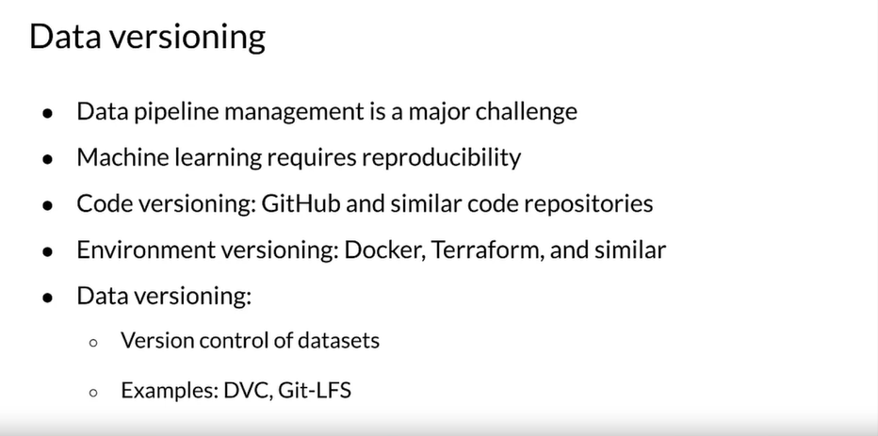
Notes:
Some ways to monitor data versioning

Slide 13
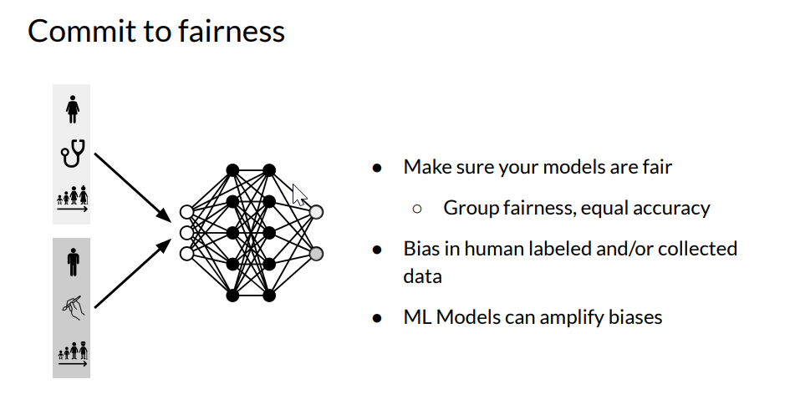
Notes:
Fairness | Coursera
Measuring Fairness | Coursera
So important in today’s world. We want to always commit to ETHICAL fairness and STATISTICAL fairness. We would rather build a model that takes 3 months and is perfect than roll something out in a week that will cause more harm than good. Remind the business of this if they are ever pushing too hard on results that will not meet our ETHICAL/STATISTICAL requirements as a team.

Slide 14
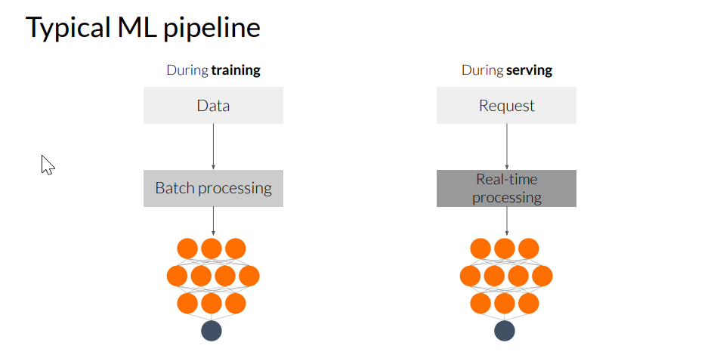
Notes:
For the ML engineers, when starting a project, keep the end in mind, do we need real time processing or batch?

Slide 15
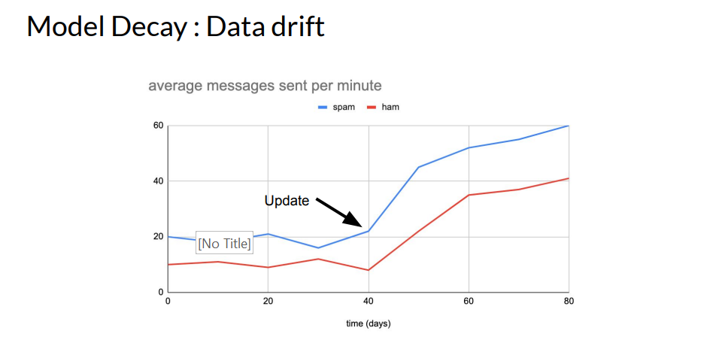
Notes:
Example

Slide 16
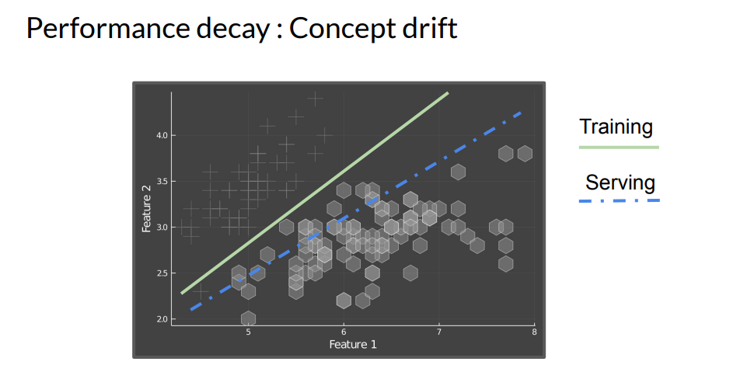
Notes:
Example

Slide 17
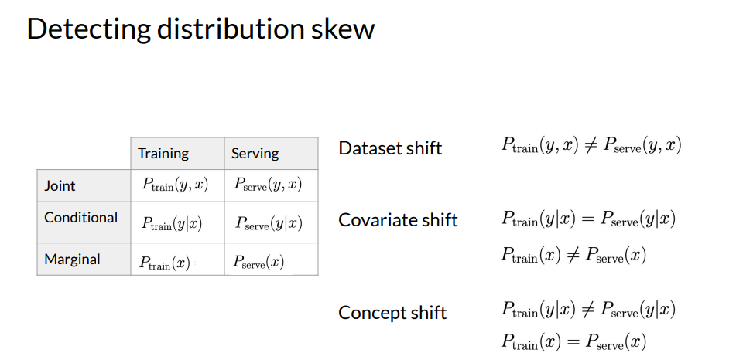
Notes:
Which skew do you have? Why? It matters on how we can fix it. Some simple formulas to think of

Slide 18
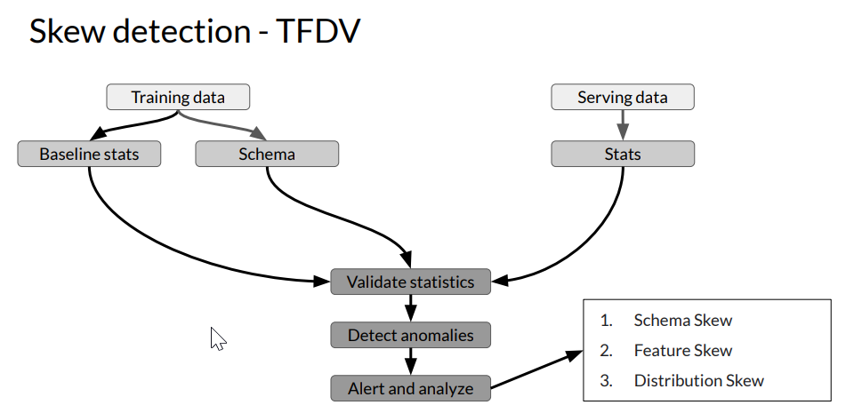
Notes:
Skew detection and where to solve for it, this is how the component of the pipeline works

Slide 19
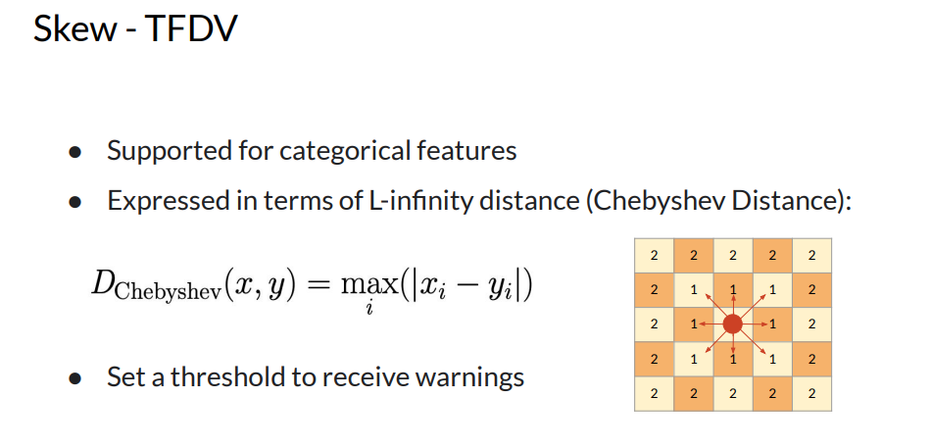

Slide 20
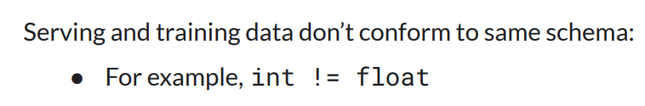
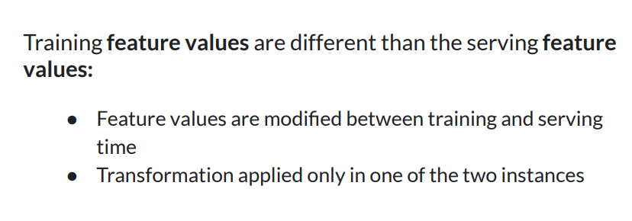
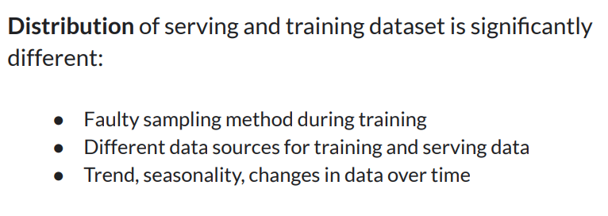
Schema Skew Feature Skew Distribution Skew

Slide 21
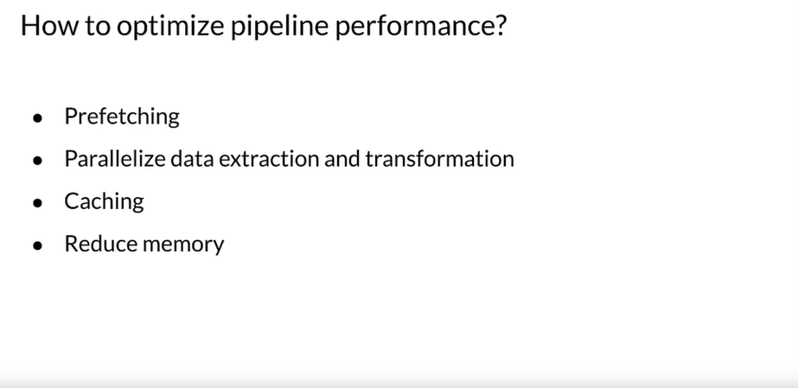
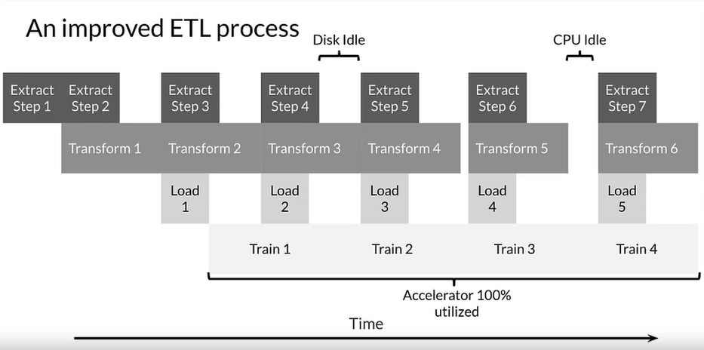
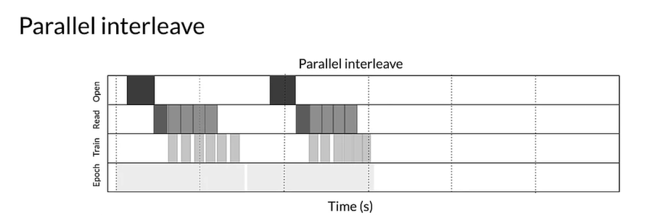
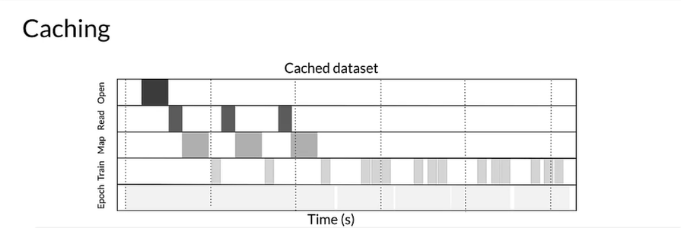
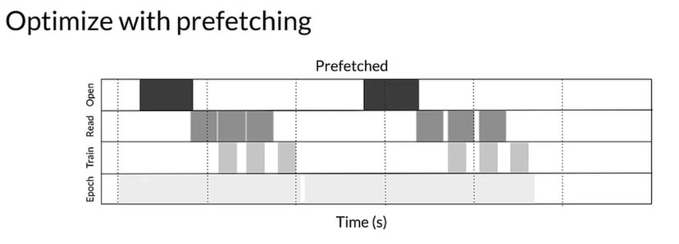
Notes:
Somethings to consider in a pipeline, if you cache data it may be quicker during training because it does not have to fetch each time

Slide 22
Feature Transformation

Slide 23
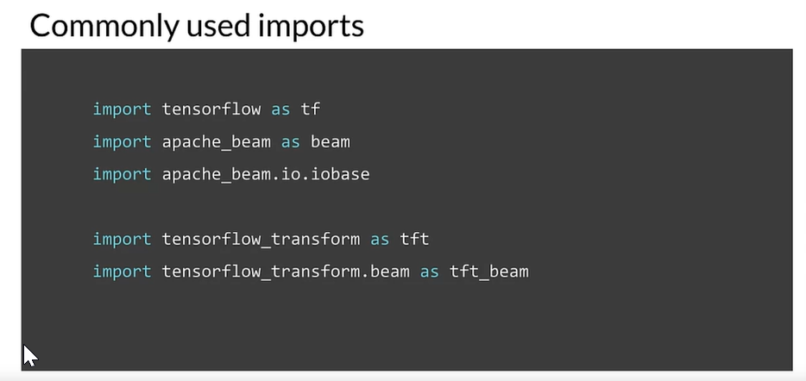

Slide 24
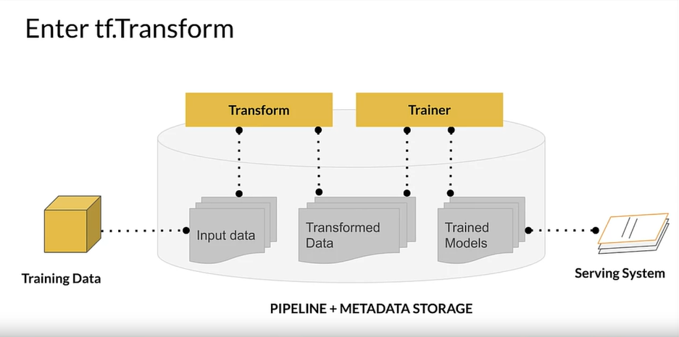
Notes:
d3c33hcgiwev3.cloudfront.net/tE0lZgdTRriNJWYHU2a4Fw.processed/full/720p/index.mp4?Expires=1701993600&Signature=IWaU~lyxg5WgG18pz-vQcwOJqml6HyWaTUNwuE5yunbLjGFgvuNlq1U9xLIUJMEgueX~yLudtZ4f9Zvjhphlxf7DylKA~tkt3xUlxRLqQ7fEa3ocbMmqNkbjU7Lq24bjGbNWI-fYKo3rssLZTaekkvQE7u5X8GRJko-O4FSp3SI_&Key-Pair-Id=APKAJLTNE6QMUY6HBC5A

Slide 25
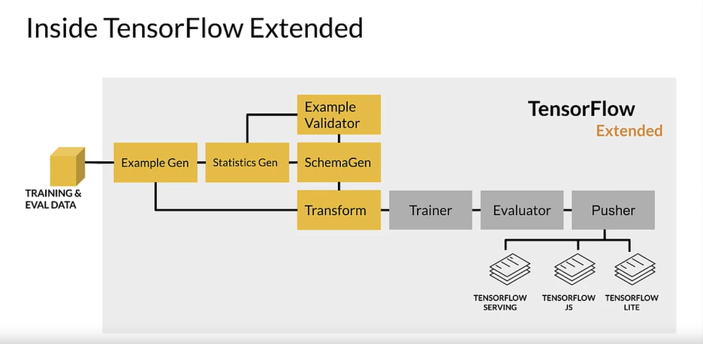
Notes:
Split to example gen, then calculates stats, schema gen infers types.
Example validator will validate
Transform does feature eng
d3c33hcgiwev3.cloudfront.net/tE0lZgdTRriNJWYHU2a4Fw.processed/full/720p/index.mp4?Expires=1701993600&Signature=IWaU~lyxg5WgG18pz-vQcwOJqml6HyWaTUNwuE5yunbLjGFgvuNlq1U9xLIUJMEgueX~yLudtZ4f9Zvjhphlxf7DylKA~tkt3xUlxRLqQ7fEa3ocbMmqNkbjU7Lq24bjGbNWI-fYKo3rssLZTaekkvQE7u5X8GRJko-O4FSp3SI_&Key-Pair-Id=APKAJLTNE6QMUY6HBC5A

Slide 26
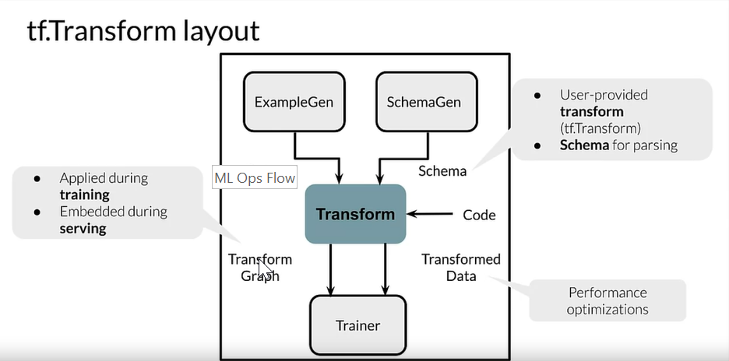
Notes:
d3c33hcgiwev3.cloudfront.net/tE0lZgdTRriNJWYHU2a4Fw.processed/full/720p/index.mp4?Expires=1701993600&Signature=IWaU~lyxg5WgG18pz-vQcwOJqml6HyWaTUNwuE5yunbLjGFgvuNlq1U9xLIUJMEgueX~yLudtZ4f9Zvjhphlxf7DylKA~tkt3xUlxRLqQ7fEa3ocbMmqNkbjU7Lq24bjGbNWI-fYKo3rssLZTaekkvQE7u5X8GRJko-O4FSp3SI_&Key-Pair-Id=APKAJLTNE6QMUY6HBC5A
Inside transform component from last slide.
Transform uses user code, the graph is what is fed to trainer.

Slide 27
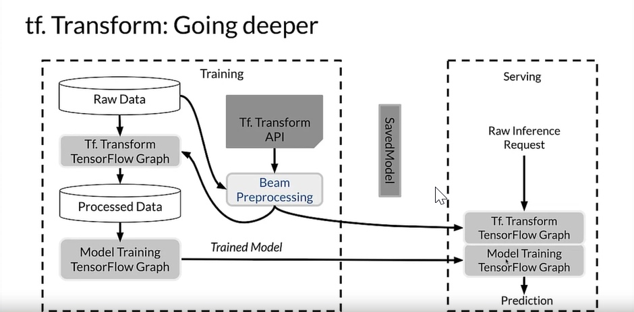
Notes:
Inside transform deeper, raw data gets transformed in first graph, then processed data get puts in model training graph.
Transform api, use apache beam for processing.
So the transform graph and trained graph serve predictions

Slide 28
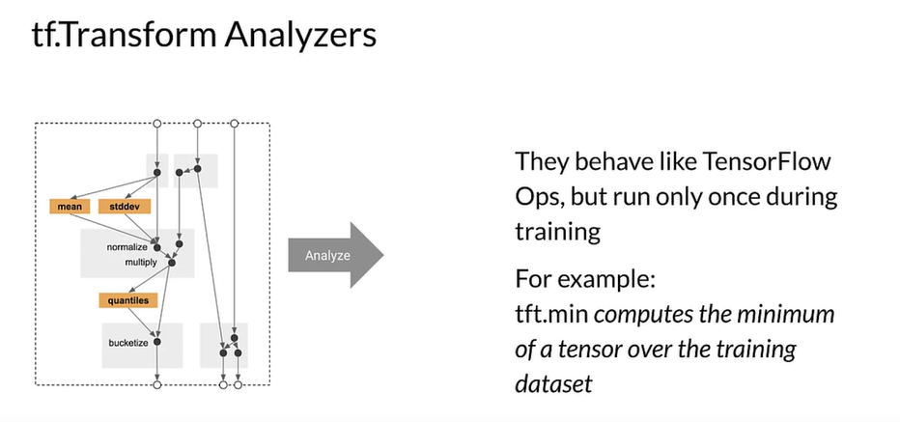
Notes:
Inside transform but how the analyzers work.
Example: if we do min max we have to do it over the whole dataset so this is only done once over the training set so then we can use in real time. This is saved to a tensor graph.

Slide 29
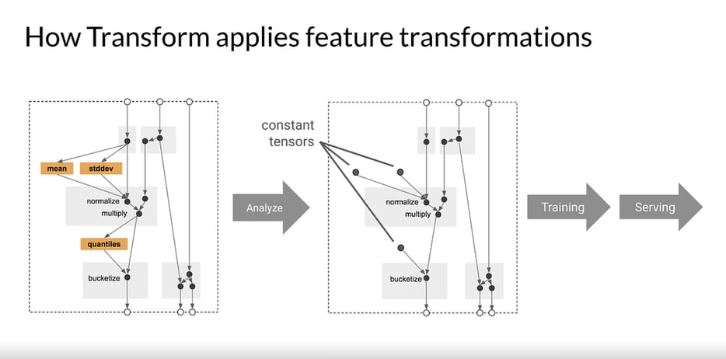
Notes:
Start with a graph that is our feature engineering, then we run it over the data that we want to analyze. What need these graphs for is that so later when we run it through individual examples we will develop a response. We do this so we don’t have to do a pass over the whole dataset later on
This stops from training and serving skew

Slide 30
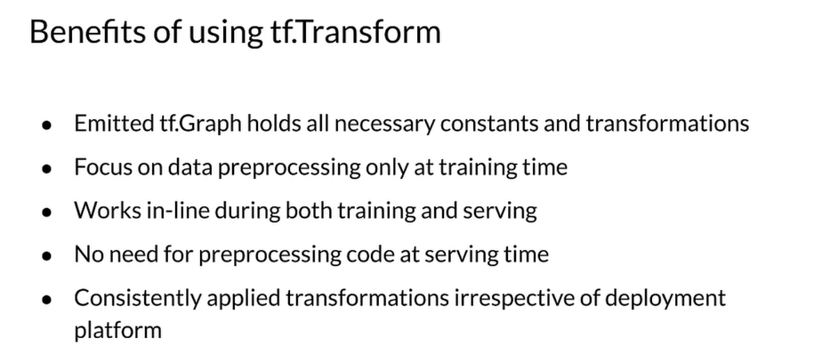

Slide 31
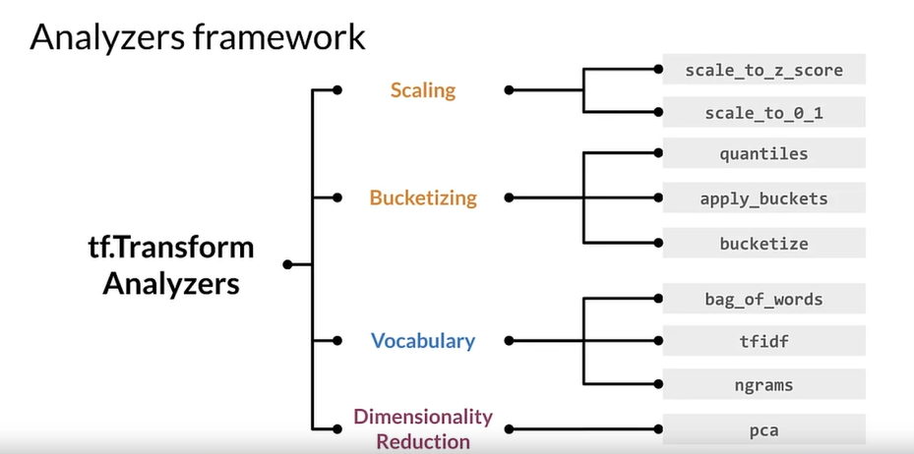

Slide 32
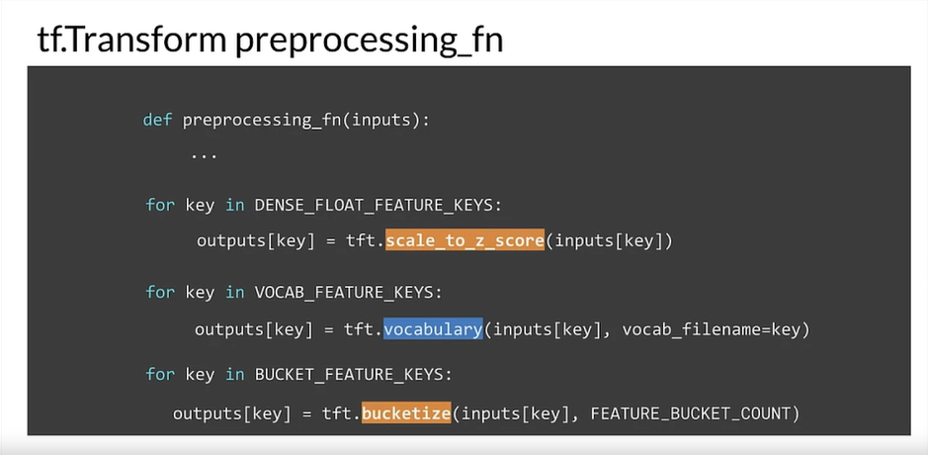
Notes:
Watch hello world video to see an example of how implemented.

Slide 33
Feature Selection

Slide 34
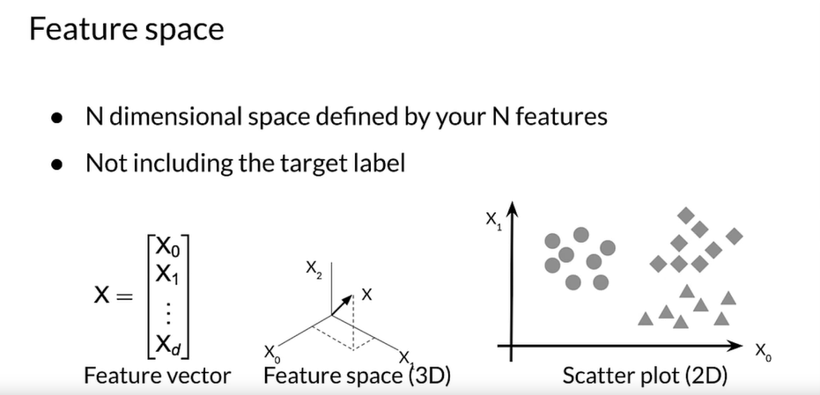
Notes:
Feature space, 2 featutes 2 dimensions and so forth
We want to reduce unneeded features for inference costs as well as reduce storage costs
Also is more intuitive for others to understand

Slide 35
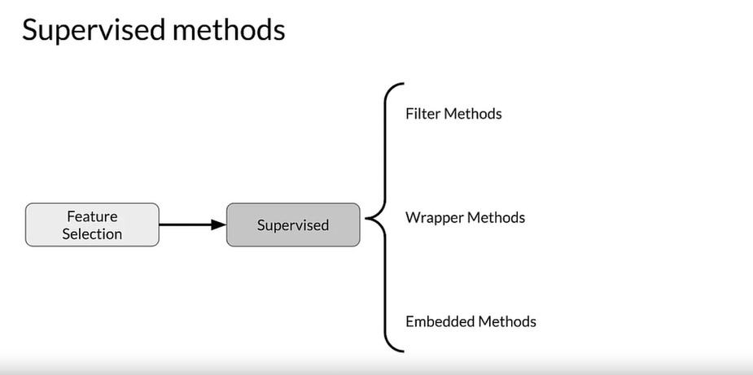

Slide 36
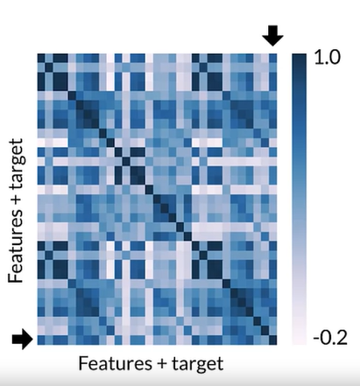
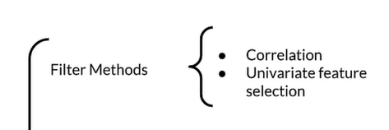
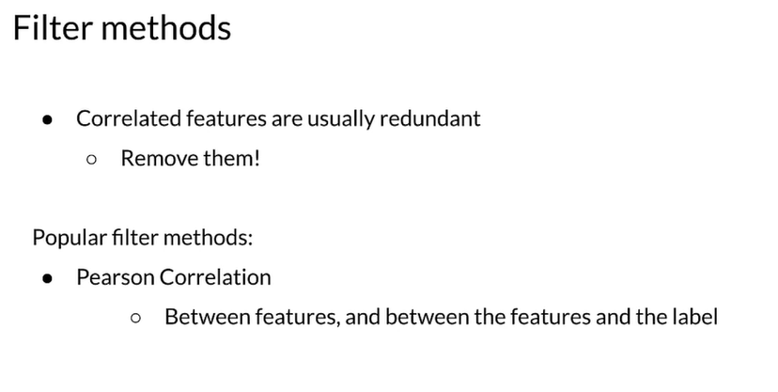
Filter Methods
Notes:
Filter method is very common, we can use correlation to figure out which ones to remove. Matrix helps visually.
There are a lot of different correlation metrics so make sure to pick the right one for feature correlation

Slide 37
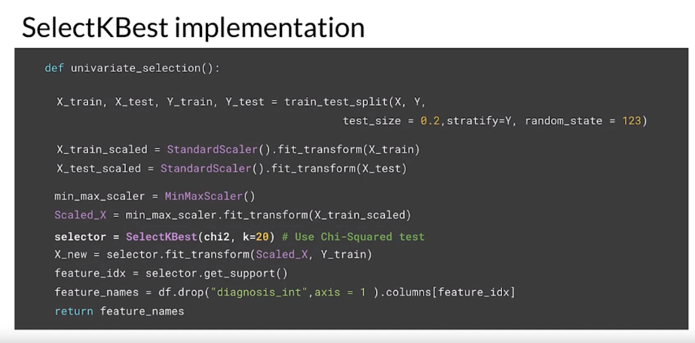
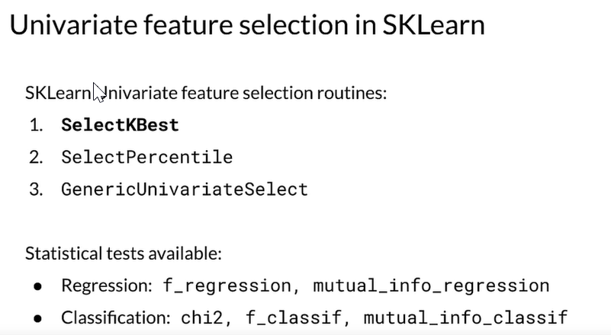
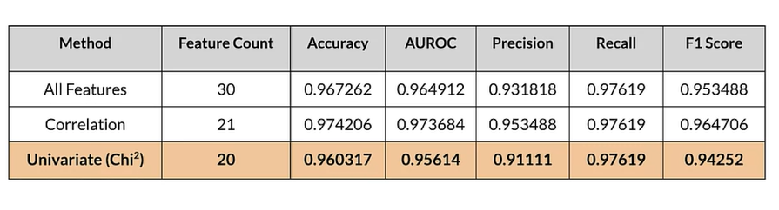
Other filter methods

Slide 38
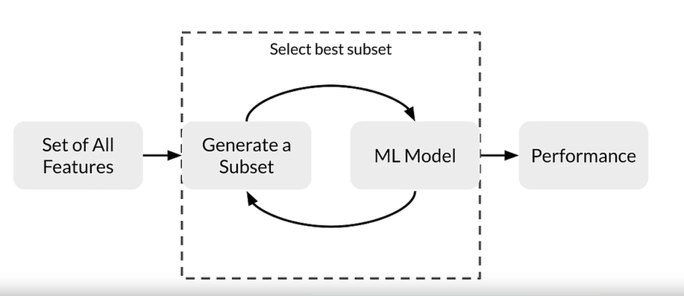
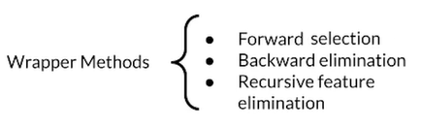
Wrapper Methods
Notes:
Wrapper methods use a model, which take the results and train a subset of the data on the model and pick the best features from there

Slide 39
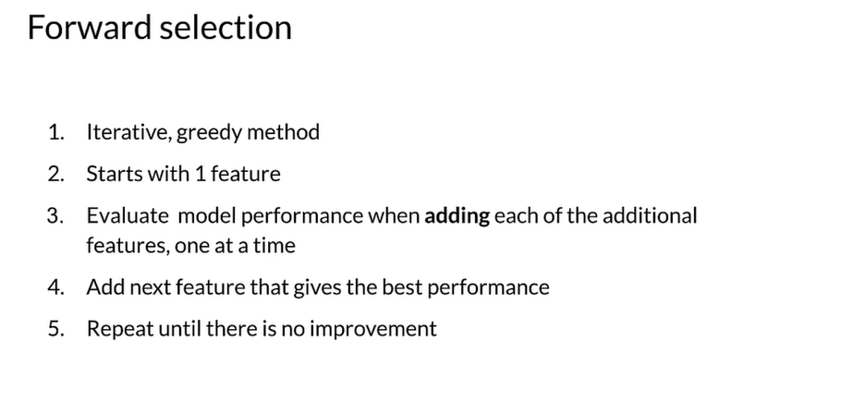
Notes:
Is a greedy method that starts with one feature and then evaluates the performance by adding each of the features until it gives the best

Slide 40
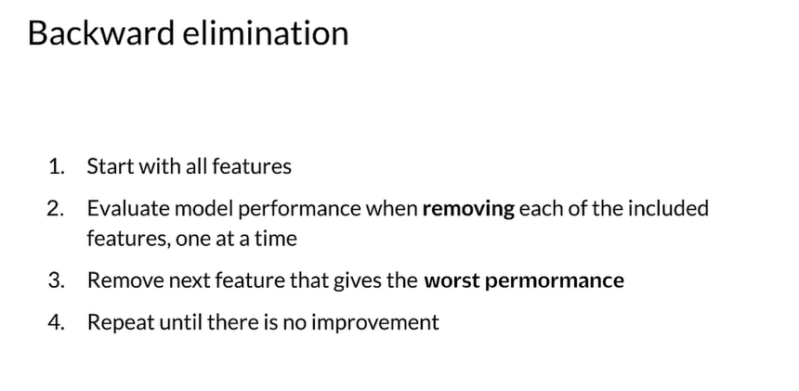
Notes:
Opposite of forward elimination

Slide 41
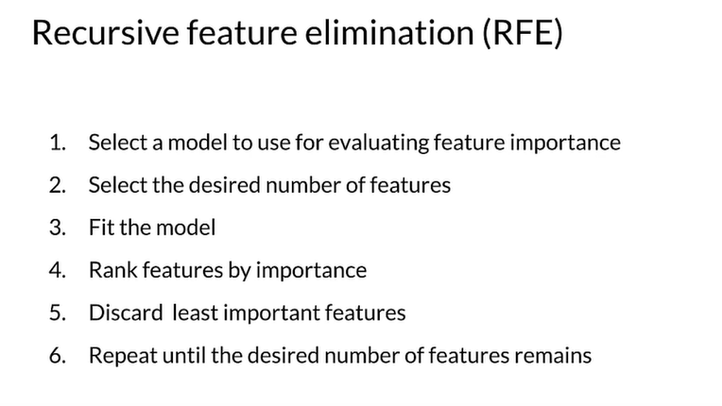


Notes:
Recursive you must choose the amount of features you want and then will rank the features. The key to this is you have to choose a model that can deliver feature importance. Our example is random forest

Slide 42





Embedded Methods
Notes:
Feature importance has to use a model that has that available.
Feature importance uses only 14 and has almost the same scores

Slide 43
Metadata

Slide 44

Notes:
Metadata can be used to track lineage and provenance in the cycle so you can debug or improve your process
ML Metadata in Action | Coursera

Slide 45

Notes:
Deeper dive into metadata
Executor: where code lives
ML Metadata in Action | Coursera

Slide 46

Notes:
Top level are all the components of a ml pipeline
Underneath (metadata store): we need to have the metadata store across the whole pipeline so any component can access and store metadata throughout the pipeline
Heart of metadata store are the artifacts
Storage of metadata can be held in databases
ML Metadata in Action | Coursera

Slide 47

Notes:
how to set up databases, we can use sql,, block storage etc
ML Metadata in Action | Coursera

Slide 48
Optimization
Notes:
Feature Stores | Coursera
Neural Architecture Search | Coursera
Other Techniques | Coursera
Dimensionality Reduction Techniques | Coursera
Mobile, IoT, and Similar Use Cases | Coursera

Slide 49

Notes:
Do you need to optimize? Good idea to think of before hand depending on where the model will be deployed. Is latency important or does it not matter as much?
Benefits and Process of Quantization | Coursera

Slide 50

Notes:
Using 8 bit bucketizing can cause only a small loss of precision but save immensely on computation
Benefits and Process of Quantization | Coursera
Post Training Quantization | Coursera
Quantization Aware Training | Coursera
Quantization | Coursera

Slide 51

Notes:
Pruning | Coursera
Maybe consider pruning for your model

Slide 52
High-Performance Modeling
Notes:
Distributed Training | Coursera
Training Large Models - The Rise of Giant Neural Nets and Parallelism | Coursera
High-Performance Modeling | Coursera

Slide 53



Notes:
Distributed Training | Coursera
Data parallelism
Train on the data on each of the worker nodes and then waits for the next round of training after all batches have been processed
One device strategy – prefetched
Mirrored – one replica per device, kept in sync by communicating updates.
Parameter

Slide 54
Knowledge Distillation
Notes:
Teacher and Student Networks | Coursera

Slide 55

Notes:
If you have an overly complex model you should consider knowledge distillation., this is the idea that you can create student models that are less complex to represent the teacher, (the more complex model). The teacher teaches the network of student models
Teacher is trained first
Student:
Matches p distribution of teacher’s predictions to form soft targets
This in part gives us insight into the teacher

Slide 56

Notes:
Most common approach:
Quantitative distillation
Distill an ensemble of models

Slide 57
Model Production Analysis (Monitoring)
Notes:
Model Performance Analysis | Coursera
TFMA in Practice | Coursera
TensorFlow Model Analysis | Coursera
Continuous Evaluation and Monitoring | Coursera - This has azure monitoring options

Slide 58

Notes:
Continuous Evaluation and Monitoring | Coursera
How does monitoring happen? Generally we want it to be on the raw data after it has been trained and labeled in addition we want to also monitor on the predictions from the processed data from the model.

Slide 59

Notes:
One way to monitor data in production is to use statistical process control.
This is a supervised learning monitored control
Stream of data is stationary
Assumes a binomial distribution

Slide 60

Notes:
Another supervised learning method.
This uses a truth table, such as TP, FP, FN, TN
Calculate the four rates, precision, specificity, etc

Slide 61

Notes:
Supervised technique.
In this method we calculate the error rate on each window and then aggregate it to check to see how it is performing.
Compare this to the hoef f ding bound

Slide 62



Notes:
Unsupervised techniques.
Continuous Evaluation and Monitoring | Coursera
Beware that this will check to see if there are anomalies outside of the bounds of the clusters but if you have a high dimensional set of data the curse of dimensionality may take a roll and be unusual. So high dimensional sets may not work;.
Cluster based drift.
Feature distribution monitoring
Model dependent monitoring, concentrates efforts near the low predicted spaces, and measure if there are more than lie in those places. This could trigger risk.

Slide 63

Notes:
Introduction to TensorFlow Model Analysis | Coursera
Once we have a model in production we want to make sure there is not much decay and that it still performs well on the dataset in a real life scenario.
The example above is how tensorflow model analysis works on the production level data.
Apache beam is what sends the data to be analyzed
Finally we write results to disk

Slide 64

Notes:
We can compare many models as well as their versions to see how they are performing.
Something to be aware of is that if you are monitoring your model in production your model may perform well at an aggregate level but it is important to take slices of your data to test it over that as well.
When testing over sliced data the model may not perform as well and these could be areas of disparity that need to be addressed.
EXAMPLE: if you slice your data you could see that your model performs really well on predicting tips for a taxi ride at night but not during the day.

Slide 65
Model Debugging
Notes:
Model Debugging Overview | Coursera
Benchmark Models | Coursera
Adversarial Attack Demo | Coursera
Residual Analysis | Coursera – regression models
Sensitivity Analysis and Adversarial Attacks | Coursera
Model Remediation | Coursera
Model Remediation and Fairness | Coursera

Slide 66

Notes:
Compare to other models to get a benchmark
Sanity test
Sensitivity analysis, if you remove a feature does this drastically change the model? If so then the model is very sensitive to this feature.
Change the data for these features synthetically
Partial dependence plots
Cleverhans and foolbox can be used to detect if your model is vulnerable

Slide 67
Model Interpretability
Notes:
Model Agnostic Methods | Coursera
Permutation Feature Importance | Coursera

Slide 68

Notes:
Depending on the type of model there are many ways to interpret it. These are some methods that will work no matter the model type

Slide 69




Notes:
PDP: Monte Carlo method. N is the number of examples, S is the features that we are interested in, and C are all other features.
What the average partial functions features dependence is
Permutation Feature Importance: For permutation feature importance, we measure the importance of a feature by measuring the increase in the prediction error after permuting that feature. A feature is important if shuffling its values increases the model error. Because in this case, the model relied on the feature for the prediction. A feature is unimportant if shuffling its values leaves the model error unchanged. Because in this case, the model ignored the feature. Think of using shapley values or SHAP

Slide 70
Model Serving
Notes:
Introduction to Model Serving | Coursera
git clone git@github.com:https-deeplearning-ai/machine-learning-engineering-for-production-public.git
A Complete Guide for Deploying ML Models in Docker - Analytics Vidhya
Improving Prediction Latency and Reducing Resource Costs | Coursera
Model Servers: Other Providers | Coursera
Documentation on model servers | Coursera

Slide 71

Notes:
Potential way to deploy to a web application, flask is very common and can be done relatively quick

Slide 72

Notes:
Many different type of serving providers, this is an example using tensorflow.

Slide 73

Notes:
A typical servable is a tensorflow saved model but it could also be something like a look up table for an embedding. The loader manages a servable lifecycle. The loader API enables common infrastructure independent from specific learning algorithms, data or whatever product use cases were involved. Specifically loaders standardized the API is for loading and unloading a servable. Together these produce aspired versions and these represent the set of servable versions that should be loaded and ready. Sources communicate this set of servable versions for a single servable stream at a time when a source gives a new list of aspired versions to the manager. It supersedes the previous list for that servable stream. The manager unloads any previously loaded versions that no longer appear in the list. The Manager then handles the full life cycle of the servable, including loading the servable serving the servables and of course unloading the servable. The managers will listen to the sources and will track all of the versions according to a version policy and the servable handle provides the exterior interface to the client

Slide 74


Slide 75

Notes:
The front end is responsible for handling your requests and your responses. It handles both requests and responses coming in from clients and the model life cycle. The back end users model workers that are running instances of the model loaded from a model store. They're responsible for performing the actual inference. You can see that multiple workers can be run simultaneously on TorchServe. They can be different instances of the same model or they could be instances of different models. Instantiating more instances of a model enables handling more requests at the same time and can increase the throughput. A model is loaded from cloud storage or from local hosts. TorchServe support serving of eager mode models and jet saved models from PyTorch. The server supports APIs for management and inference, as well as plugins for common things like server logs, snapshots, and reporting.

